Slide 1






Lecture 26:
Styling in React
Course - Web Development - II
-By
Instructor Name
welcome@krmangalam.edu.in
Sohna Road,Gurugram,Haryana 122103

Slide 2

| Table of Contents
Inline Styling vs. CSS Modules.
Styled Components & Emotion Library.
Tailwind CSS in React.
Theming & Global Styles.
References.
The End.

Slide 3

|
Now that we know how to build components, how do we style them to look modern, clean, and user-friendly?

Slide 4
|
Now that we know how to build components, how do we style them to look modern, clean, and user-friendly?
Now that we’ve built the structure of our components, it’s time to give them a visual identity — just like decorating a house after it's built.
In React, there are multiple ways to style components, each with its own use case and benefits.
Inline Styles.
CSS Stylesheets.
CSS Modules.
Styled Components.

Slide 5
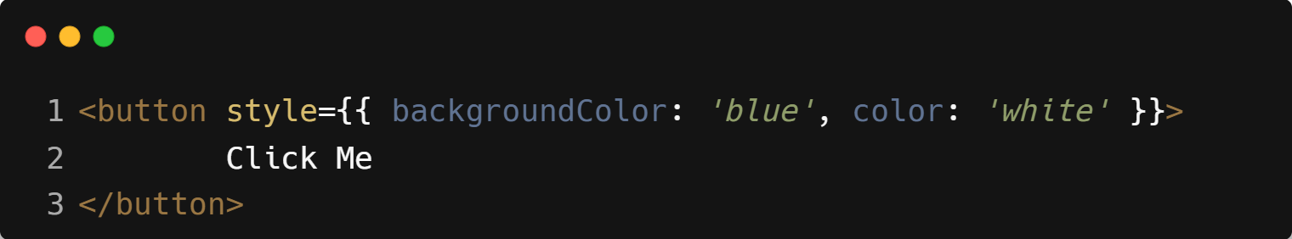
| Inline Styles
Apply styles directly to elements using the style prop.
Great for quick, one-off changes.
Example :

Slide 6
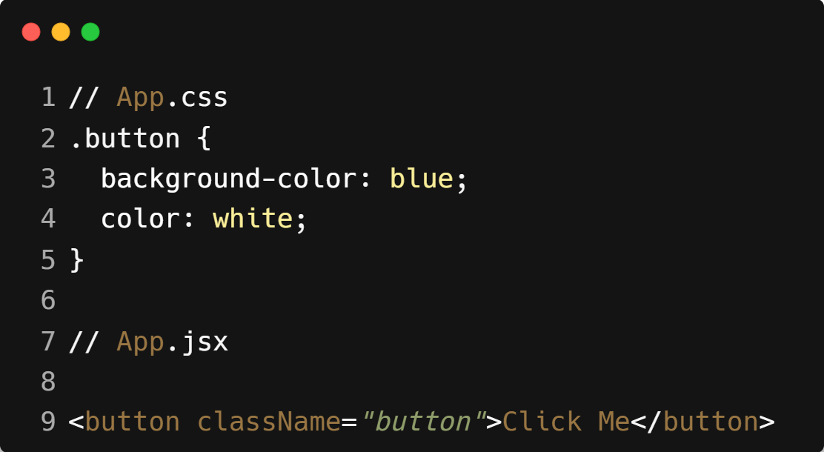
| CSS Stylesheets
Use standard .css files and className in JSX.
Clean and separates logic from design.
Example :

Slide 7
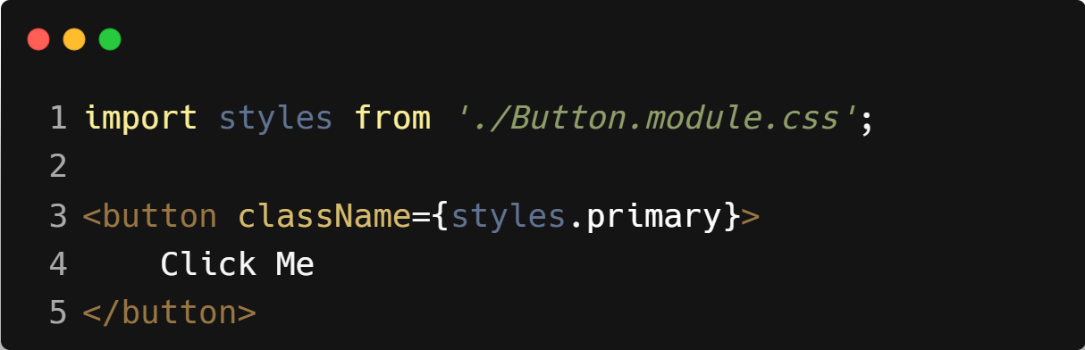
| CSS Modules
CSS Modules are a way to scope your CSS to individual components, so that styles don’t leak out or clash with styles from other components.
Instead of using global .css files where class names might collide, CSS Modules create locally scoped class names automatically.
Example :
ClassName

Slide 8
| Inline Styles vs CSS Modules
Feature | Inline Styles | CSS Modules
Where? | Inside component (style={{}}) | Separate .module.css file
Syntax | JS object (camelCase) | Normal CSS (kebab-case)
Scoped? | Yes (element-level) | Yes (auto-generated class names)
Reusable? | No | Yes
Dynamic Styles | Easy with props/state | Needs logic with clsx
Hover/Focus | Not supported | Supported
Media Queries | Not supported | Supported
Theming | Easy | Needs setup

Slide 9

| Coding Questions
1. Inline Styling
Task :
Create a React component named AlertBox. Inside the component, create a JavaScript object named alertStyle. This object should define a backgroundColor of lightcoral, a color of white, and padding of '16px'. Apply this style object to a <div> that contains the text "This is an alert!".

Slide 10
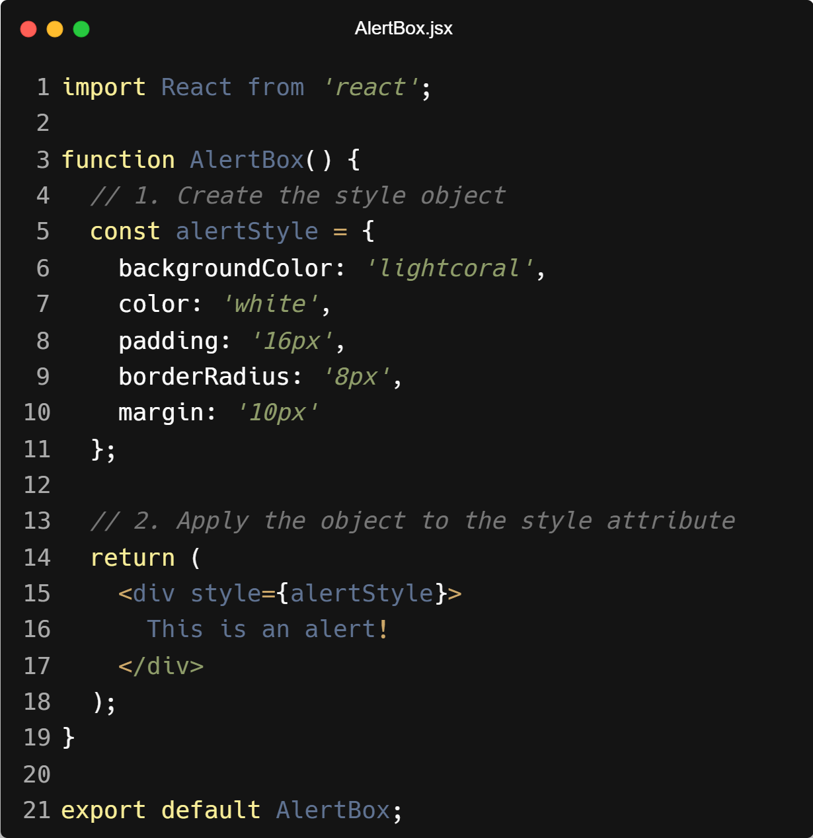
| Coding Questions
Solution :

Slide 11
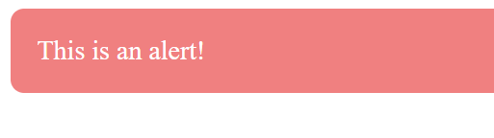
| Coding Questions
Output :

Slide 12
| Coding Questions
2. Basic CSS Modules
Task :
Create a CSS file named Button.module.css. Inside it, define a class .primaryButton with some styles (e.g., background color, padding, border).
Create a Button component in Button.jsx.
Import the styles from Button.module.css.
Apply the imported class to a <button> element.

Slide 13
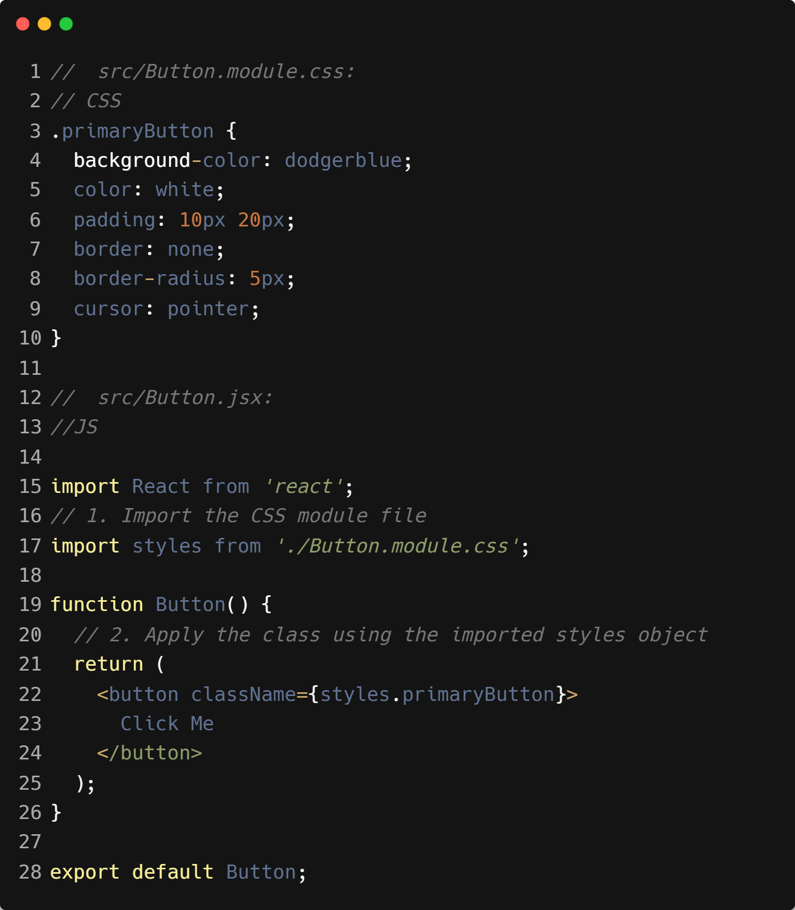
| Coding Questions
Solution :

Slide 14

| Coding Questions
Output :

Slide 15

|
Why switch between CSS and JS files when you could write CSS right where your component lives?

Slide 16
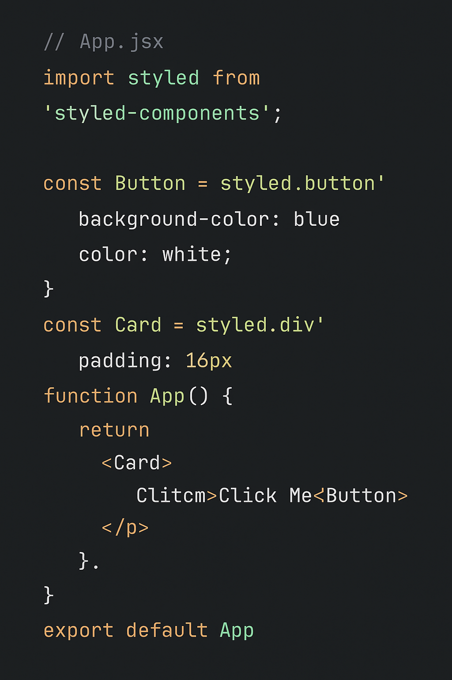
|
Why switch between CSS and JS files when you could write CSS right where your component lives?
Because writing CSS directly in your component — like with Styled Components or Emotion — keeps your styles scoped, reusable, and easier to maintain, all in one place.
No more file switching, class name clashes, or scattered styles — just clean, component-driven styling where it belongs.

Slide 17
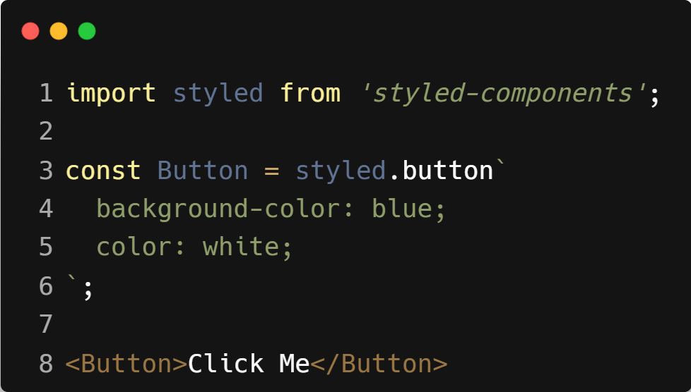
| Styled Components
Uses JavaScript to create styled components.
Combines styling + logic in one file — great for theming and reusable UI.
Installation : npm install styled-components
Example :

Slide 18
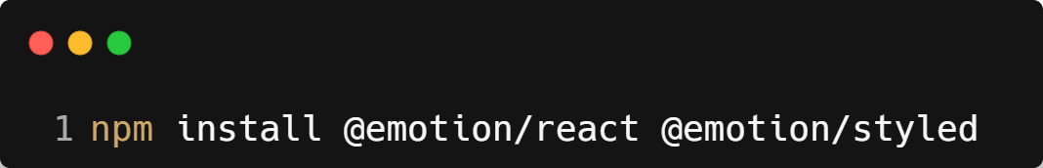
| What is Emotion in React ?
Emotion is a popular CSS-in-JS library for styling React components. It lets you write CSS directly in your JavaScript or TypeScript files, just like Styled Components, but with more flexibility and control.
Think of Emotion as a styling toolbox that combines the power of JavaScript logic with the ease of writing regular CSS.
Installation :

Slide 19
| Why use Emotion in React ?
Style your components inline or with styled components.
Scoped styles (no conflicts).
Supports themes (dark mode, custom colors).
Full dynamic styling using props, state, conditions.
Extremely fast and lightweight.

Slide 20
| Why use Emotion in React ?
Emotion Has Two Ways to Write Styles:
styled API (like Styled Components).
css Prop or Function.

Slide 21
| Styled API
The styled API is a way to create custom, styled HTML or React components using template literal CSS — directly in your JavaScript files.
It’s used by both:
styled-components
@emotion/styled (from Emotion library)
That’s why we say:
"styled API (like Styled Components)" — because Emotion and Styled Components both use the same styled syntax and idea.

Slide 22
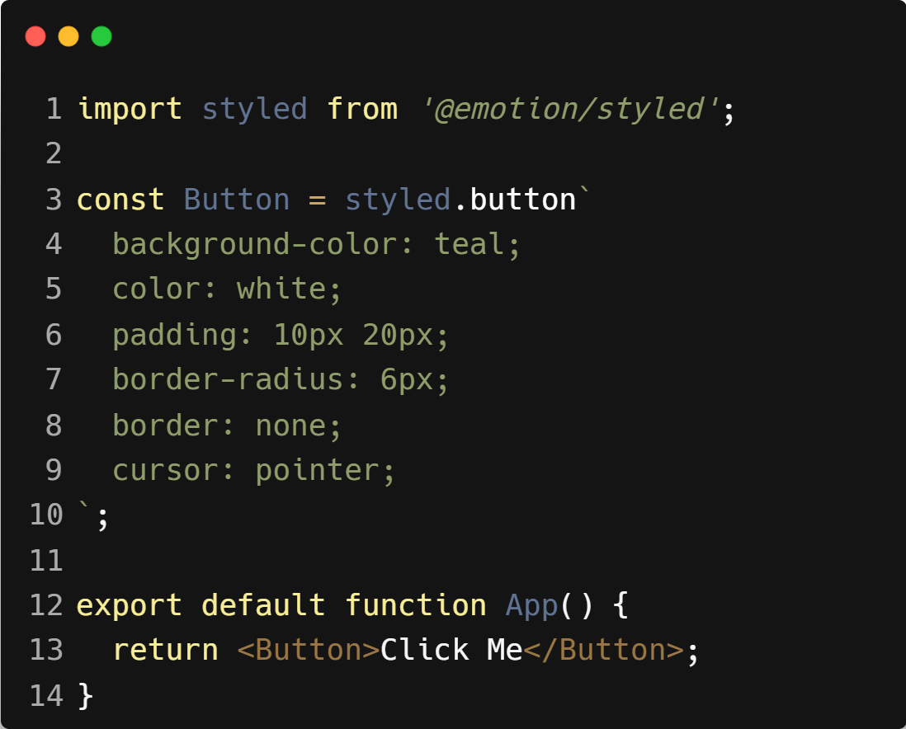
| Styled API
Example :

Slide 23
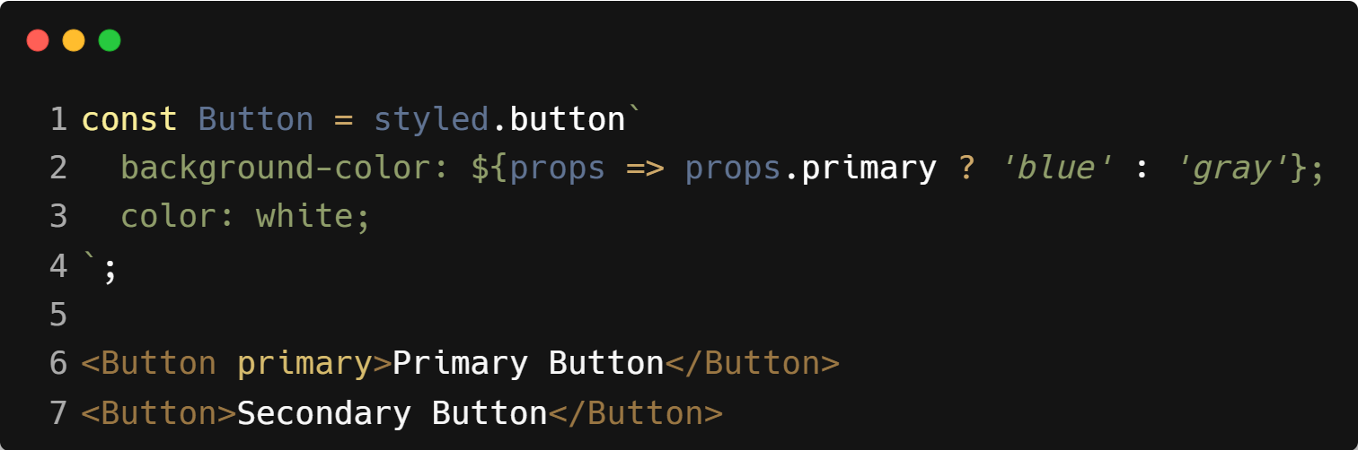
| Styled API
Dynamic Styling with Props :

Slide 24
| css Prop / css Function
The css prop and the css function are two powerful and flexible ways to style React components using Emotion’s CSS-in-JS approach.
These are more dynamic and less tightly coupled than styled, and are useful when you want:
Conditional styles
Inline dynamic styles
Reusable style blocks without creating new components

Slide 25
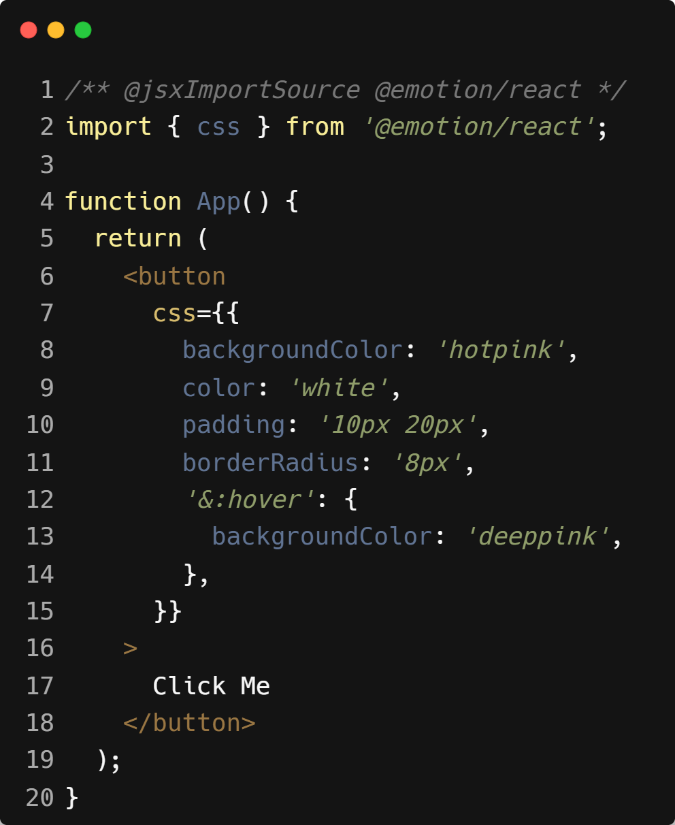
| Two Ways to Use css in Emotion
1. css Prop (Directly on Elements)
Think of it like applying style={{}}, but with full CSS power — including pseudo-classes, media queries, etc.
Example :

Slide 26
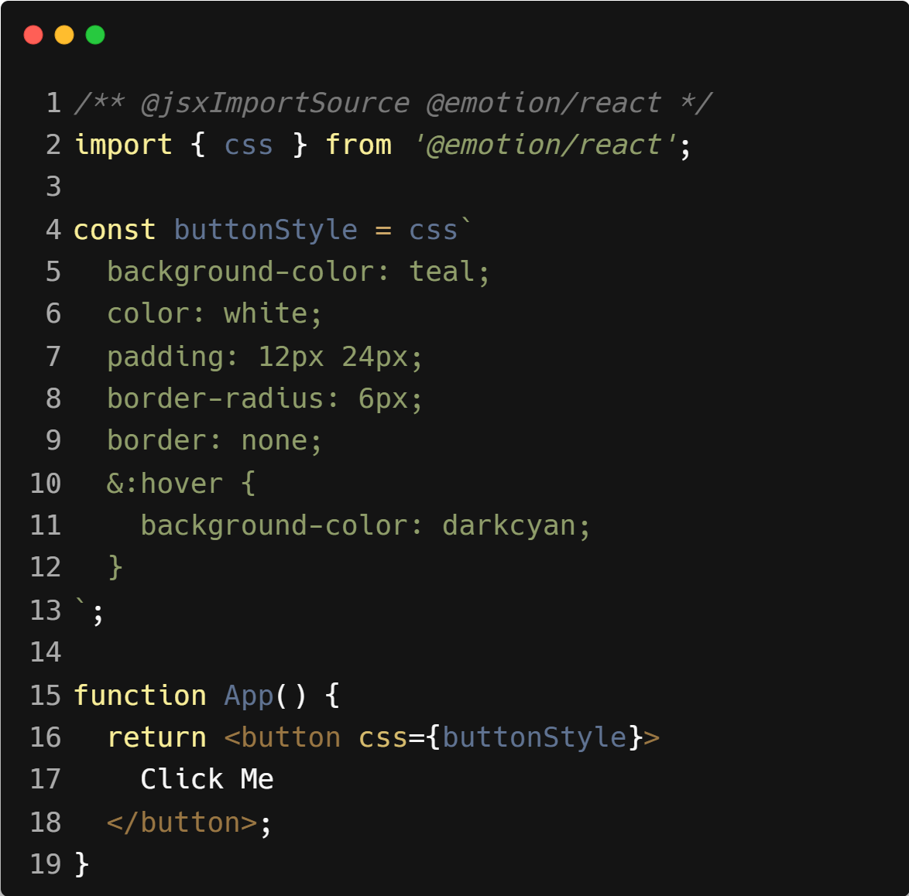
| Two Ways to Use css in Emotion
2. css Function (Reusable Style Block)
Use this when you want to define a CSS block separately and apply it via the css prop.
Example :

Slide 27

|
CSS Modules separate styles. Styled Components bring them into JS. But what if there’s a third way — faster, cleaner, and used by GitHub and Notion?

Slide 28

|
CSS Modules separate styles. Styled Components bring them into JS. But what if there’s a third way — faster, cleaner, and used by GitHub and Notion?
That third way is Utility-First CSS — and the most popular library for it is Tailwind CSS.
With Tailwind, you style your components using predefined utility classes directly in your JSX.
No separate CSS files. No styled wrappers. Just fast, consistent, maintainable styling — all in one place.

Slide 29
| Tailwind CSS
Tailwind CSS is a utility-first CSS framework that lets you build modern, responsive UIs directly in your HTML or JSX using predefined class names — no need to write custom CSS.
Key Features:
No custom class names needed
Perfectly suited for React and component-based frameworks
Fast development — you style while you build
Predictable and consistent design system
Built-in responsive, dark mode, hover, and animation utilities

Slide 30
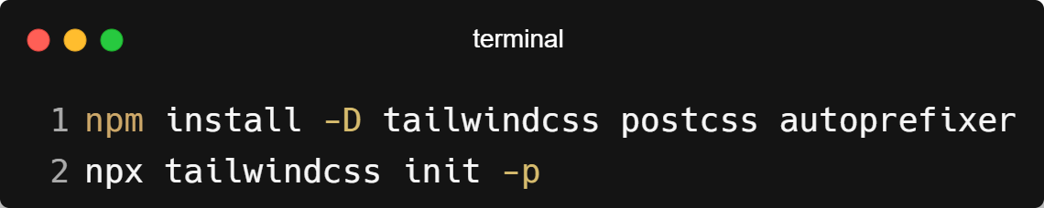
| Tailwind CSS Installation & Setup
Step 1 : Installation
This creates:
tailwind.config.js
postcss.config.js

Slide 31
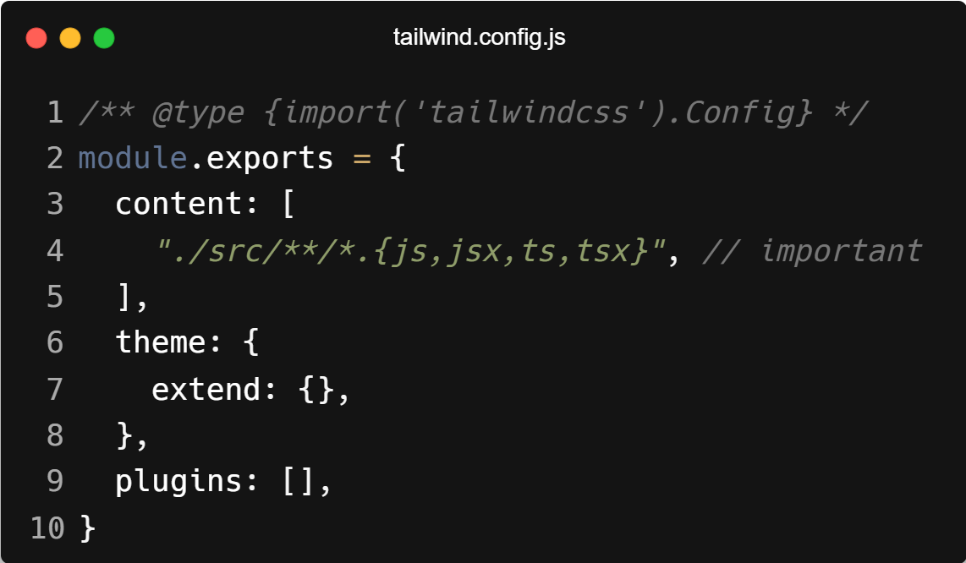
| Tailwind CSS Installation & Setup
Step 2 : Configure Tailwind to Remove Unused CSS
In tailwind.config.js, update the content array:

Slide 32
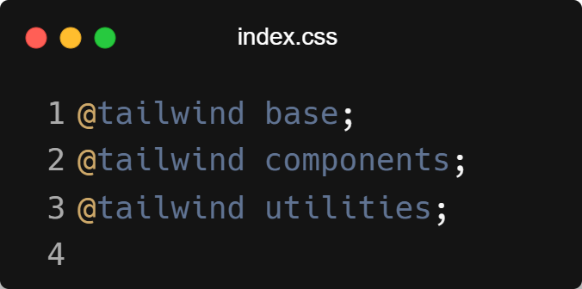
| Tailwind CSS Installation & Setup
Step 3 : Add Tailwind Directives to Your CSS
In src/index.css (or App.css), replace everything with:

Slide 33
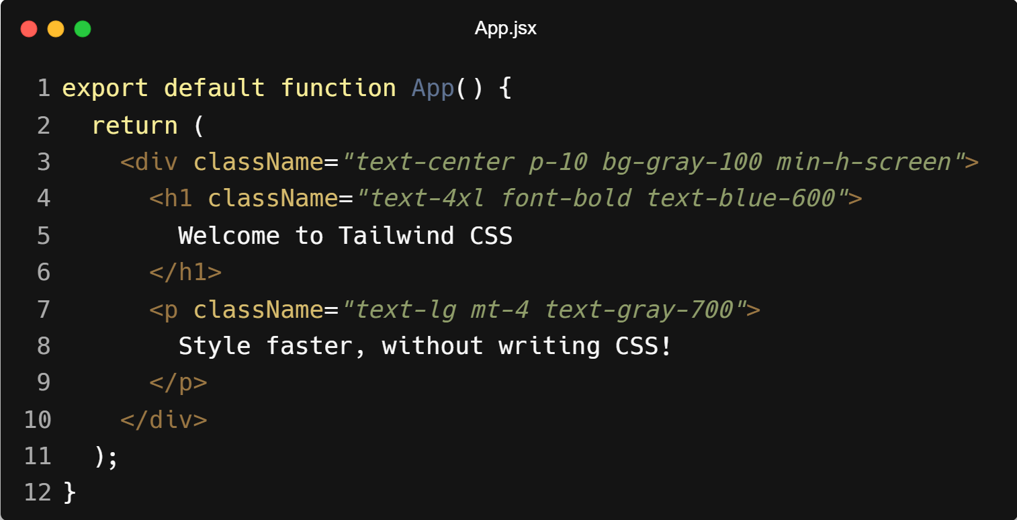
| Tailwind CSS Installation & Setup
Step 4 : Use Tailwind Classes in Your JSX
Now you can write Tailwind classes directly in your components:

Slide 34
| Tailwind CSS Most Common Classes
Colors
bg-blue-500 – background color
text-red-600 – text color
border-green-400 – border color
hover:bg-blue-700 – hover background
Spacing (Margin & Padding)
p-4 – padding on all sides
px-6 – horizontal padding
py-2 – vertical padding
m-4 – margin
mt-2, mb-2, ml-4, mr-4 – margin top, bottom, left, right

Slide 35
| Tailwind CSS Most Common Classes
Typography
text-lg, text-xl, text-2xl – font sizes
font-bold, font-semibold, font-light – font weight
text-center, text-left, text-right – alignment
uppercase, lowercase, capitalize – text transform
Layout
flex, flex-row, flex-col – Flexbox layout
justify-center, justify-between – horizontal alignment
items-center, items-start – vertical alignment
grid, grid-cols-2, grid-cols-3 – grid layout
gap-4, gap-x-2, gap-y-6 – spacing in grids/flex

Slide 36
| Tailwind CSS Most Common Classes
Sizing
w-full, w-1/2, w-64 – width
h-screen, h-16, h-auto – height
max-w-md, min-w-full – width constraints
Borders & Radius
border, border-2 – adds border
border-gray-300 – sets color
rounded, rounded-lg, rounded-full – border-radius

Slide 37
| Tailwind CSS Most Common Classes
Shadows & Effects
shadow, shadow-md, shadow-lg – box shadow
hover:shadow-xl – hover effect
opacity-75 – transparency
Background & Gradient
bg-gray-100, bg-white, bg-black – solid backgrounds
bg-gradient-to-r from-purple-500 to-pink-500 – gradient
Responsive Utilities
sm:text-sm, md:text-lg, lg:text-xl, xl:text-2xl – responsive font sizes
hidden md:block – hide on small, show on medium+

Slide 38

|
Would you rather define your brand’s colors and fonts once, or rewrite them every time you style a button?

Slide 39
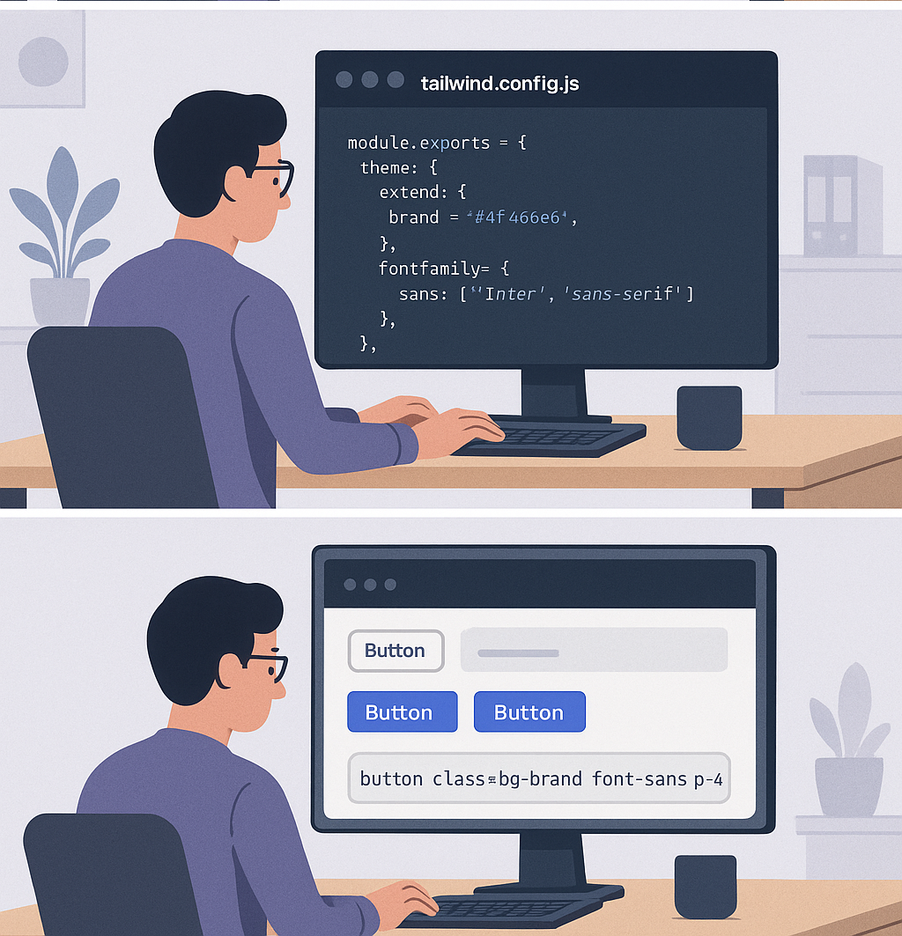
|
Would you rather define your brand’s colors and fonts once, or rewrite them every time you style a button?
Of course, you'd define them once! Why waste time rewriting colors, fonts, and spacing every time you style a button?
That’s the power of Theming in Tailwind CSS — you define your brand's look (like fonts, colors, and breakpoints) once in tailwind.config.js, and reuse those styles anywhere with simple utility classes.

Slide 40
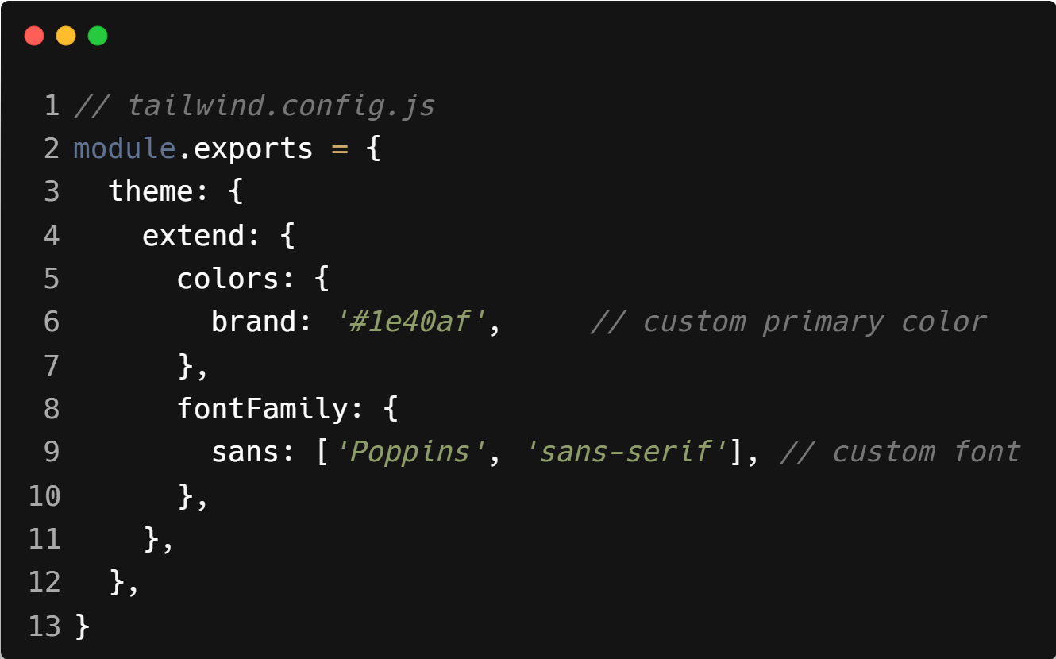
| Theming in React
Theming means defining a consistent visual style (like colors, fonts, spacing, etc.) across your entire app.
In Tailwind, you customize themes using the tailwind.config.js file.
Example :

Slide 41
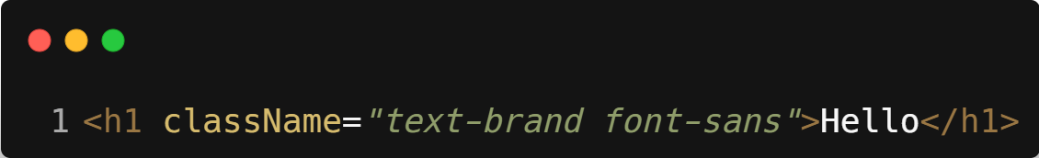
| Theming in React
Use case :
This helps you build a branded, consistent UI instead of mixing styles randomly.

Slide 42

|
Would you give every student different uniforms — or enforce one dress code for all?

Slide 43
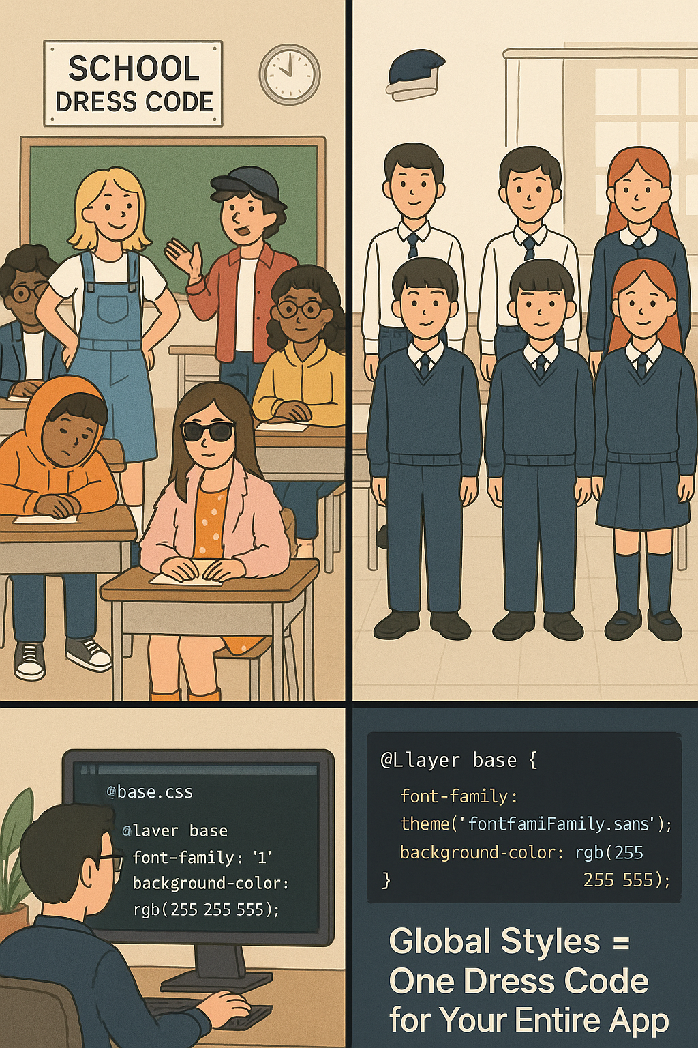
|
Would you give every student different uniforms — or enforce one dress code for all?
Of course, you’d enforce one dress code for all! It ensures consistency, clarity, and a sense of unity — no confusion, no clashes.
That’s exactly what Global Styles do in Tailwind CSS.
They apply base-level styling (like default fonts, background colors, heading sizes, etc.) across your entire app, so every page and element starts from the same consistent foundation — just like everyone wearing the same dress code, no matter which classroom they’re in.

Slide 44
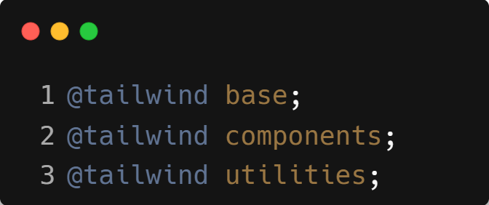
| Global Styles - Base Layer Styling
Global styles are default base styles applied across all elements, like resetting margins, body font, or button behavior.
In Tailwind, global styles are handled via:

Slide 45
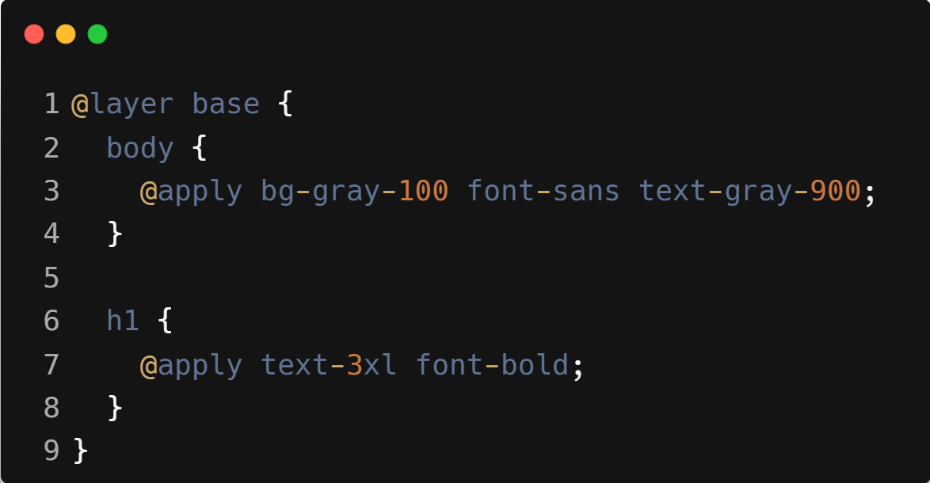
| Global Styles - Base Layer Styling
You can also add custom global styles inside your main CSS file:
All <body> elements will use bg-gray-100, font-sans, and text-gray-900 by default,
and all <h1> tags will have text-3xl and font-bold — unless overridden with custom utility classes.

Slide 46
| Global Styles vs Theming
Feature | Global Styles | Theming
Purpose | Sets base/default styles across your entire app (e.g., fonts, background) | Defines design tokens like colors, spacing, and typography for reuse
Scope | Applies universally to all elements unless overridden | Applied through context or config (e.g., theme provider or Tailwind config)
Example Use | Setting a body font or default heading size | Defining a primary color or font family to use consistently across components
Goal | Provide a consistent base or reset for the app | Provide a customizable design system
How It’s Used | Tailwind’s @layer base or CSS resets | Tailwind’s theme.extend or styled-components’ ThemeProvider
Override Style? | You override styles at component level | You reference theme tokens for consistent values

Slide 47
| Check Your Understanding
Question : How do you apply inline styles to a React element?
Options : a) style="color: 'blue';"
b) style={{ color: 'blue' }}
c) style="color: blue"
d) style={ color: blue }
Answer : b) style={{ color: 'blue' }}
Explanation:
Inline styles in React are passed as a JavaScript object. The outer curly braces {} enter JSX into JavaScript mode, and the inner curly braces {} define the style object itself.

Slide 48
| Check Your Understanding
Question : What is the main benefit of using CSS Modules?
Options : a) It allows you to write CSS directly inside your JavaScript files.
b) It automatically scopes your CSS class names locally to the component, preventing naming
conflicts.
c) It is the only way to use animations in React.
d) It combines all your CSS into a single global file.
Answer : b) It automatically scopes your CSS class names locally to the
component, preventing naming conflicts.
Explanation:
CSS Modules solves the global scope problem of traditional CSS by generating unique class names for each component (e.g., Component_className_1a2b3c), ensuring styles don't leak out and affect other components.

Slide 49
| Check Your Understanding
Question : What is Tailwind CSS?
Options : a) A JavaScript library for creating animations.
b) A component library like Material-UI.
c) A utility-first CSS framework for rapidly building custom designs directly in your markup.
d) A library for creating styled-components.
Answer : c) A utility-first CSS framework for rapidly building custom designs
directly in your markup.
Explanation:
Tailwind provides low-level utility classes (like p-4, flex, text-lg) that you compose together in your JSX to build designs without writing custom CSS.

Slide 50
| Check Your Understanding
Question : When using inline styles in React, how would you write the CSS property
font-size?
Options : a) font-size
b) 'font-size'
c) fontSize
d) font.size
Answer : c) fontSize
Explanation:
CSS properties that contain a hyphen (kebab-case) must be converted to camelCase when used in JavaScript style objects.

Slide 51
| Check Your Understanding
Question : What is the core concept of CSS-in-JS libraries like Styled Components or
Emotion?
Options : a) They link external .css files to your components.
b) They allow you to write actual CSS code within your JavaScript files to create React
components with styles attached.
c) They convert all your CSS into inline styles.
d) They only work with class components.
Answer : b) They allow you to write actual CSS code within your JavaScript files to
create React components with styles attached.
Explanation:
CSS-in-JS libraries let you define components with their styles encapsulated together, often using tagged template literals. This colocates the component's logic and styling.

Slide 52
| References
MDN Web Docs : Comprehensive and official documentation for JS. 🔗https://developer.mozilla.org/en-US/docs/Web/JavaScript
W3Schools – JS Tutorial : Beginner-friendly JS tutorials with examples and interactive editors. 🔗 https://www.w3schools.com/js/
react.dev - A comprehensive, tutorial-style website that deeply explores core React concepts, including components, state, effects, and hooks, through interactive examples and in-depth explanations.
🔗https://react.dev/

Slide 53
Thanks
For
Watching
Course - Web Development - II
welcome@krmangalam.edu.in
Sohna Road,Gurugram,Haryana 122103

